Slide 2
“Blow a trumpet in Zion; sound an alarm on my holy mountain!
Let all the inhabitants of the land tremble,
for the day of the LORD is coming; it is near,
a day of darkness and gloom, a day of clouds and thick darkness!”
Joel 2:1-2a ESV
“The LORD utters his voice before his army,
for his camp is exceedingly great;
he who executes his word is powerful.
For the day of the LORD is great and very awesome; who can endure it?”
- Joel 2:11

Slide 4
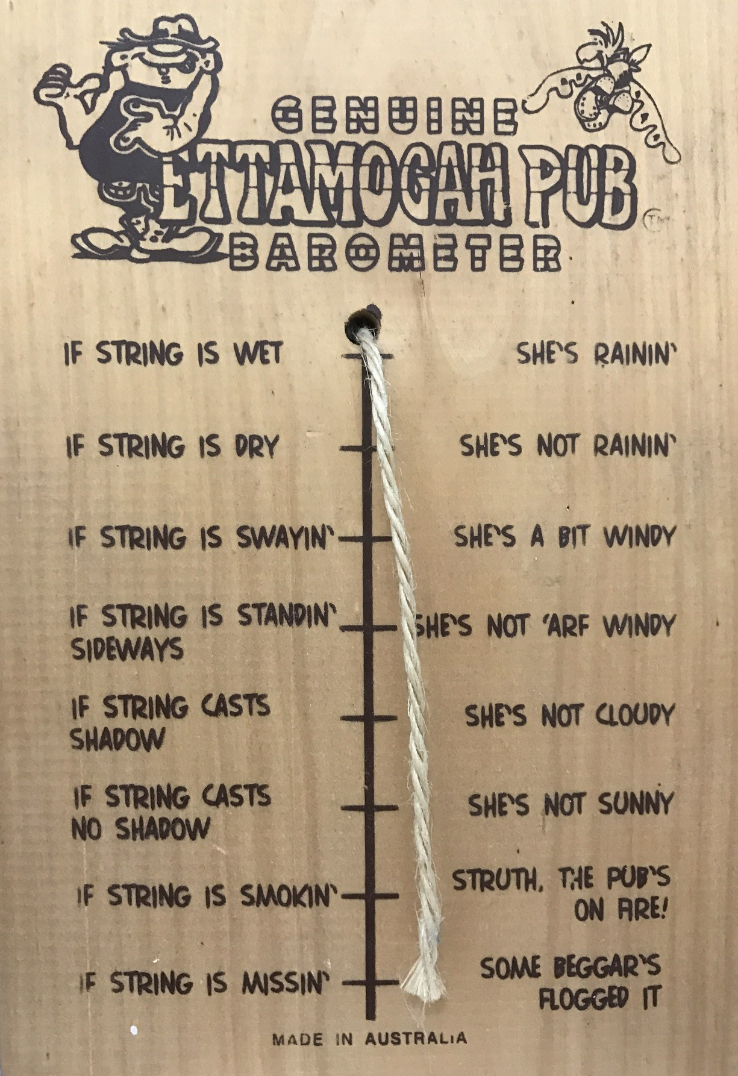
funnyjunk.com/Australian+barometer+ettamogah+pub/funny-pictures/6134730/

Slide 6
The Lord is at your right hand;
he will shatter kings on the day of his wrath.
He will execute judgment among the nations,
filling them with corpses;
he will shatter chiefs over the wide earth.
- Psalm 110:5-6 ESV

