Slide 2
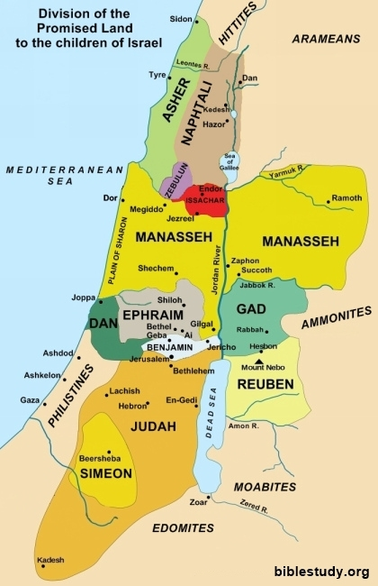

Slide 3
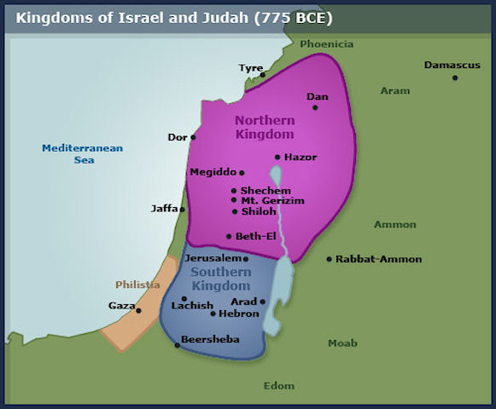

Slide 5
Q: Why does 6:4 follow 6:1-3?
Why didn’t it work?

Slide 6
Two possibilities:
6:1-3 are God’s Words, his suggestion of what to say (and Israel never say it)
6:1-3 are Israel’s words but are somehow lacking

Slide 8
Luke 13:34
O Jerusalem, Jerusalem, you who kill the prophets and stone those sent to you, how often I have longed to gather your children together, as a hen gathers her chicks under her wings, but you were not willing!

Slide 9
Luke 19:41-42
41 As he approached Jerusalem and saw the city, he wept over it 42 and said, ‘If you, even you, had only known on this day what would bring you peace – but now it is hidden from your eyes.’

